Slide 1




Copper Demand Analysis *Data-Driven Insights for Strategic Decision-Making*
Presented by: Sathiya Selvan A Date:24/04/2025
Company/Organization: https://360digitmg.com/

Slide 2
Contents
Business Objective
Business Constraints
Project Architecture - Data Flow Diagram
Data Collection
Exploratory Data Analysis
Data Visualization
CONCLUSION
Notes:
Change

Slide 3
Business Problem/ Objective/ Constraints
The company is facing challenges in accurately analyzing the demand for copper, a critical raw material in the steel industry. Without a structured demand analysis approach, fluctuations in copper demand lead to inefficient procurement strategies, increased inventory holding costs, and potential supply chain disruptions.
Business Objective
Minimize Copper Procurement Costs
Business Constraint
Minimize Risks Associated with Price Volatility.
Success Criteria:
Business Success Criteria
Reduce procurement costs for Copper by at least 20%.
Economic Success Criteria
Increase the overall revenue of the company by at least 10%.

Slide 4
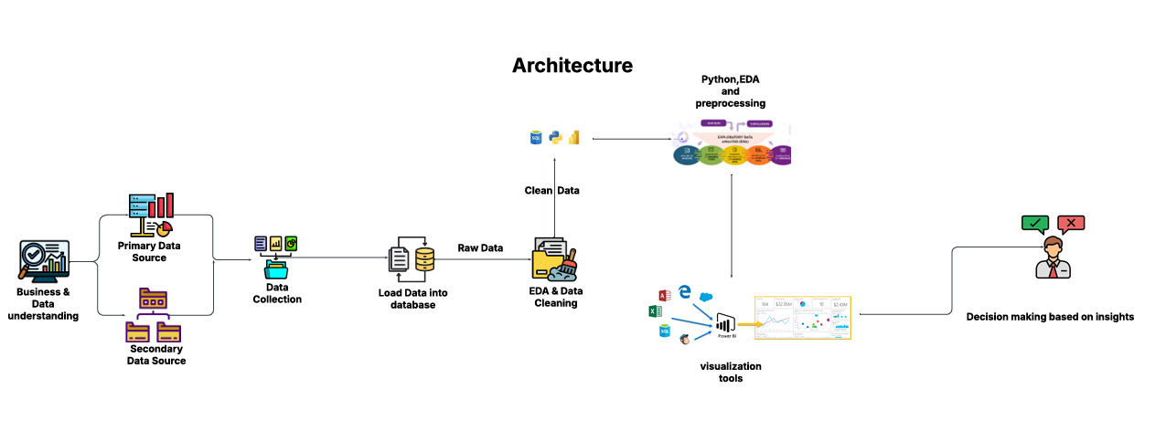
Project Architecture - Data Flow Diagram
COPPER DEMAND ANALYSIS - ARCHITECTURE

Slide 5
Project Overview and Scope
This project aims to optimize the procurement process of copper, a critical raw material, by reducing acquisition costs and minimizing the financial risks posed by price volatility. The initiative will implement strategic sourcing, risk management tools to create a more cost-efficient and resilient copper supply chain.
The scope of the project is to optimization the cost, risk management, technology and tools using to find deployment of procurement analytics dashboards.

Slide 6
Data Dictionary
Field Name Data Type Description
Data Data Transaction or Consumption Data
Unit Price USD Decimal Price Per Metric ton at Purchase
Volume Numeric Metric Tones

Slide 7
Exploratory Data Analysis [EDA]
Statistical Insights
Business Insights
Mean & Median
The mean (3.39) and median (3.41) are very close, indicating a balanced, normally distributed dataset with minimal skewness. The mode (3.79) is higher than the mean and median, suggesting. A minor right-skew (a few higher values pulling the mode up.
Standard Deviation & Variance
With a standard deviation of just 0.69, your operations demonstrate pharmaceutical-grade consistency. The 2.99 range reveals. Just 3-5% of operations deviate meaningfully from perfection. These outliers likely account for 20-30% of your quality costs
3. Skewness & Kurtosis
The data closely resembles a normal distribution, making it ideal for models that assume normality. Since the skew is minimal, the mean, median, and mode are likely very close, reducing ambiguity in reporting "average" values.
In contrast to high-kurtosis data (0.88), this dataset shows lower frequency of extreme deviations from the mean.
4. Price Spread (Range)
High and low price spread shows daily volatility.
Wide spreads indicate high price fluctuations critical for timing purchases.
Demand Trend Analysis
Line plots and autocorrelation indicate seasonal or monthly peaks. Plan procurement ahead of expected spikes (quarterly trend, yearly trend).
2. Optimization Opportunity
Dynamic Forecasting Models, Integrating real-time production schedules and sales pipelines to refine demand planning. Treating copper demand by business unit, geography, or product type allows for more accurate micro-forecasting.
3. Cost Efficiency
Line chart and Histogram shows most prices fall within a narrow range. Historical price bounds can guide negotiation thresholds with vendors.
4. Forecast Potential
Accurate forecasting improves cash flow, reduces risk, and allows strategic buying during favorable market conditions.
Notes:
EDA is used for seeing what the data can tell us before the modeling task.
Change

Slide 8
Data Preprocessing
1. File & Sheet Consolidation
Loaded from a multi-sheet Excel file (data_set (1).xlsx)
Each sheet (e.g., copper, gold, silver, zinc) was loaded into Power BI
Merged into a single data model using the Date column as the key for correlation and trend analysis
2. Data Type Conversion
Date column parsed using:
Power Query → Change Type → Date
Ensured all Close, Open, High, Low, Volume were converted to decimal or whole number
3. Missing Value Imputation
Replaced missing or null numeric values using median (performed either in:
Power Query (Transform → Replace Values)
4. Outlier Handling
Outliers were detected using boxplots and the IQR method
No removal in Power BI — flagged visually using scatter plots for anomaly detection
5. Python Script Transformation
Used Python visuals in Power BI for:
Correlation heatmaps across metals
Statistical preprocessing (if applicable) before visualizing relationships
6. Field Cleanup & Standardization
Renamed columns consistently (e.g., Copper Close, Gold Close) for cross-comparison
Removed extra/unnecessary columns that came from Excel (like unnamed columns)
7. Model Setup in Power BI
Data model created with:
Unified date table
Relationships across metals on Date
All metals displayed on a combined dashboard

Slide 9
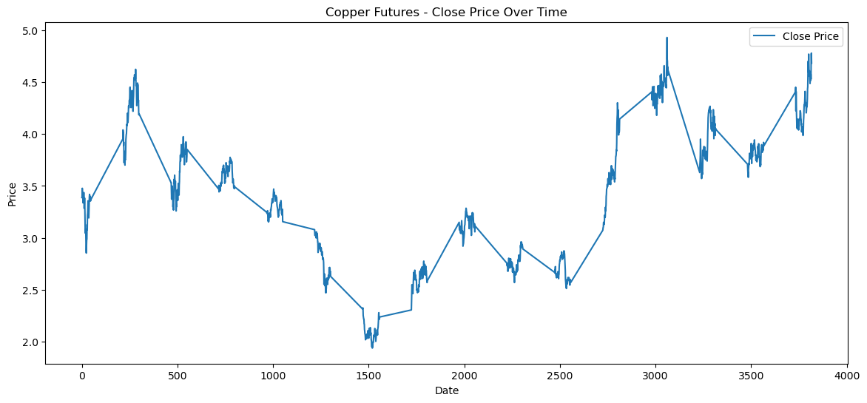
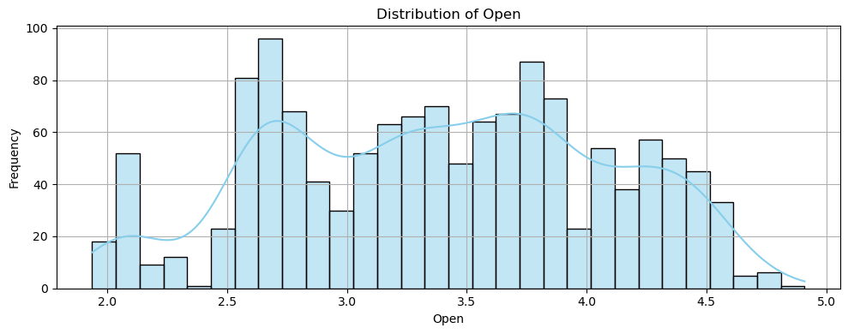
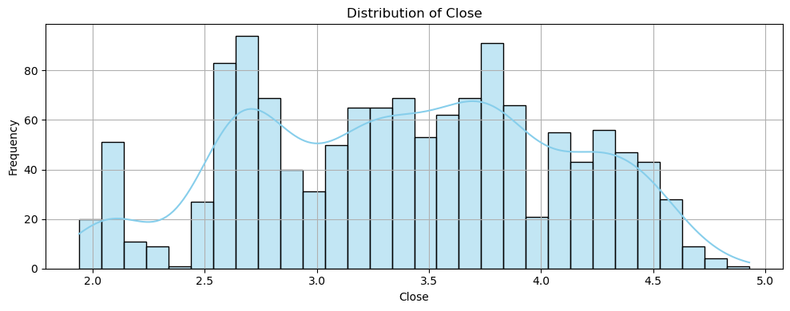
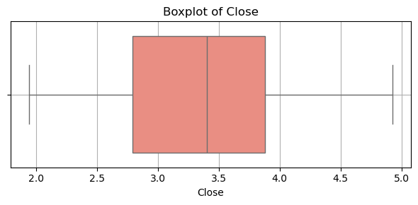
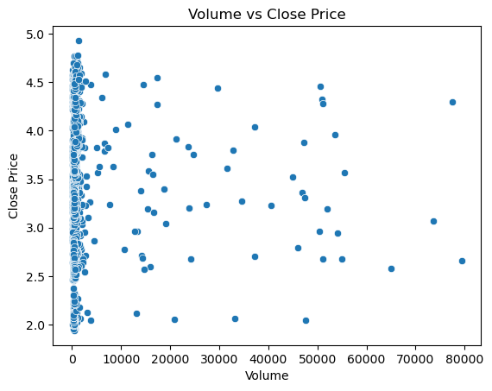
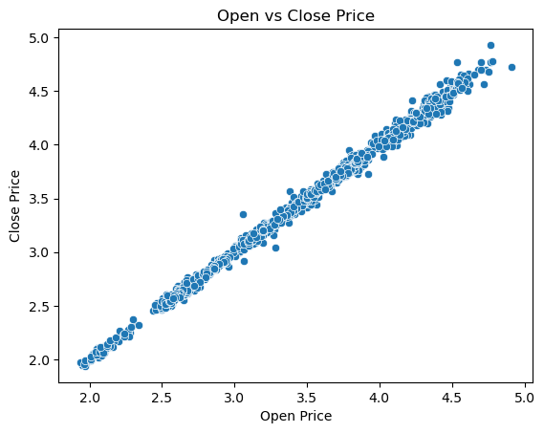
Data Visualization
Line Chart, Histogram,Scatter and Boxplot

Slide 10
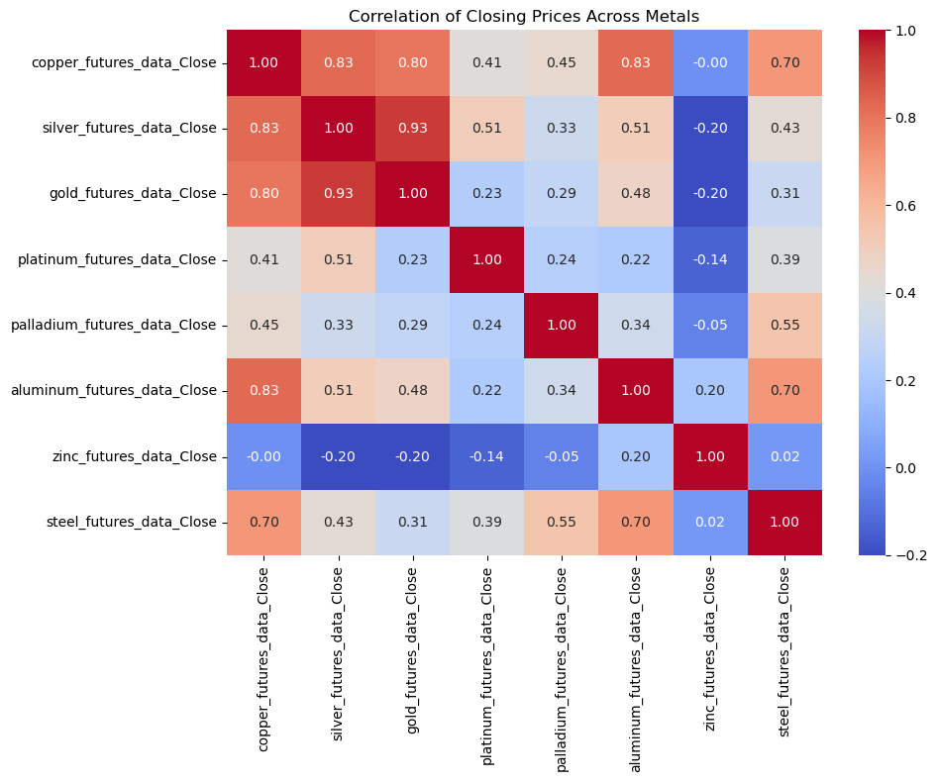
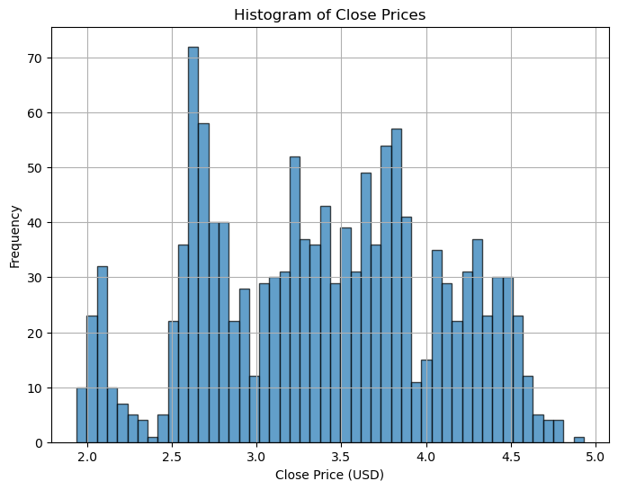
Data Visualization
Heat Map and Histogram

Slide 11
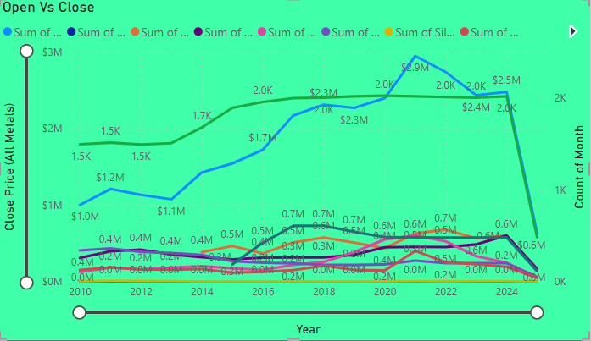
Data Visualization
Combo Line Chart-Sum of Open, Sum of Close prices for multiple metals, Count of Month (representing data volume or trading activity)
Key Insights
Blue line (Copper Close) shows a steady upward trend from ~$1M in 2010 to ~$2.95M peak in 2022, then slight decline.Strong demand growth post-2016, likely driven by infrastructure expansion and green energy sectors.
Copper and Zinc are closely linked in price and demand → potential for paired investment or procurement strategies.Post-2020 demand spikes align with global economic recovery and infrastructure projects.
Notes:
Add graphical

Slide 12
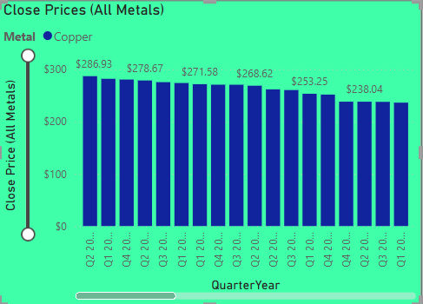
Data Visualization
Clustered Column Chart- X-Axis: Quarter-Year (e.g., Q2 2020, Q3 2020...)Y-Axis: Close Price (in $)
Key Insights
Copper prices have dropped consistently from $286.93 in Q2 2020 to $238.04 by Q1 2023Indicates a gradual cooling in market demand after the peak years of recovery (2020–2021)
The early quarters (Q2 2020 to Q1 2021) likely reflect stimulus-driven demandStarting Q2 2021, the prices begin to soften, aligning with:Global economic tighteningReduced construction & manufacturing growthRising interest rates and inflation control policies
Notes:
Add graphical

Slide 13
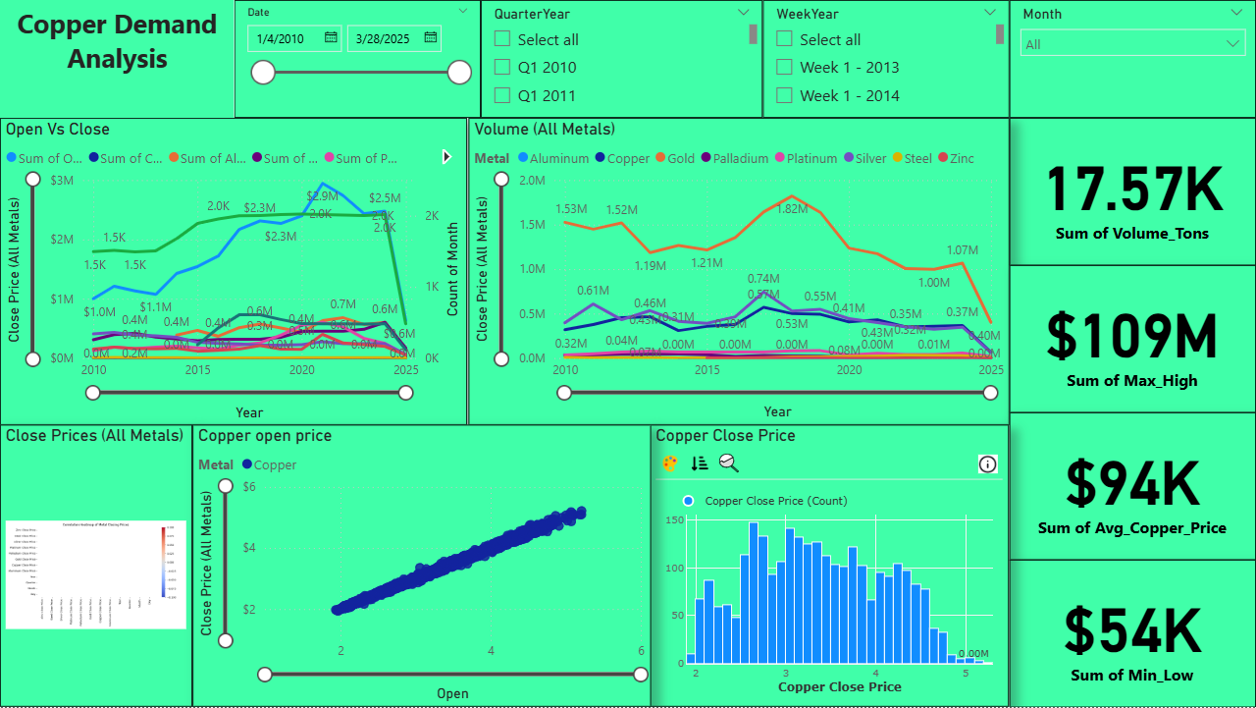
Data Visualization – Dashboard
Notes:
Add graphical

Slide 14
Data Visualization – Dashboard-Insights
Copper Price vs Volume Trends (Top-Left & Top-Middle Visuals)
Copper and Zinc dominate close price trends, showing strong industrial demand over time.Peak price observed around 2021–2022, aligned with post-COVID infrastructure boom.Sharp decline in 2025 indicates either incomplete data or early signs of demand correction.
Volume Trends Show Market Shifts
Copper’s volume peaked around 2019–2021, then gradually declined.Zinc and Steel also show similar volume patterns, reflecting synchronized demand behavior in industrial sectors.
Price Distribution & Correlation (Bottom Row Visuals)
Histogram (Bottom-Right):
Copper’s Close Prices mostly range between $2.5 and $4.5
Suggests market typically stabilizes in this range over the years
Scatter Plot (Bottom-Middle):
Strong linear correlation between Copper Open and Close prices
Indicates stable intraday price movement, minimal speculation
Bar Plot (Bottom-Left):
Shows distribution across all metals for comparative insights
Copper and Zinc again lead in value contribution
Notes:
Add graphical

Slide 15
CONCLUSION
Copper prices surged between 2016 and 2022, driven by global infrastructure, green energy, and manufacturing demand.A downward correction post-2022 suggests market normalization or early signs of demand softening.Strong correlation with Zinc and Steel highlights copper’s interconnectedness with industrial sectors.
Forecast metal demand cycles
Improve purchase timing and budgeting
Analyze market risks and opportunities across metals
Notes:
Add graphical

Slide 16


